Slide 1
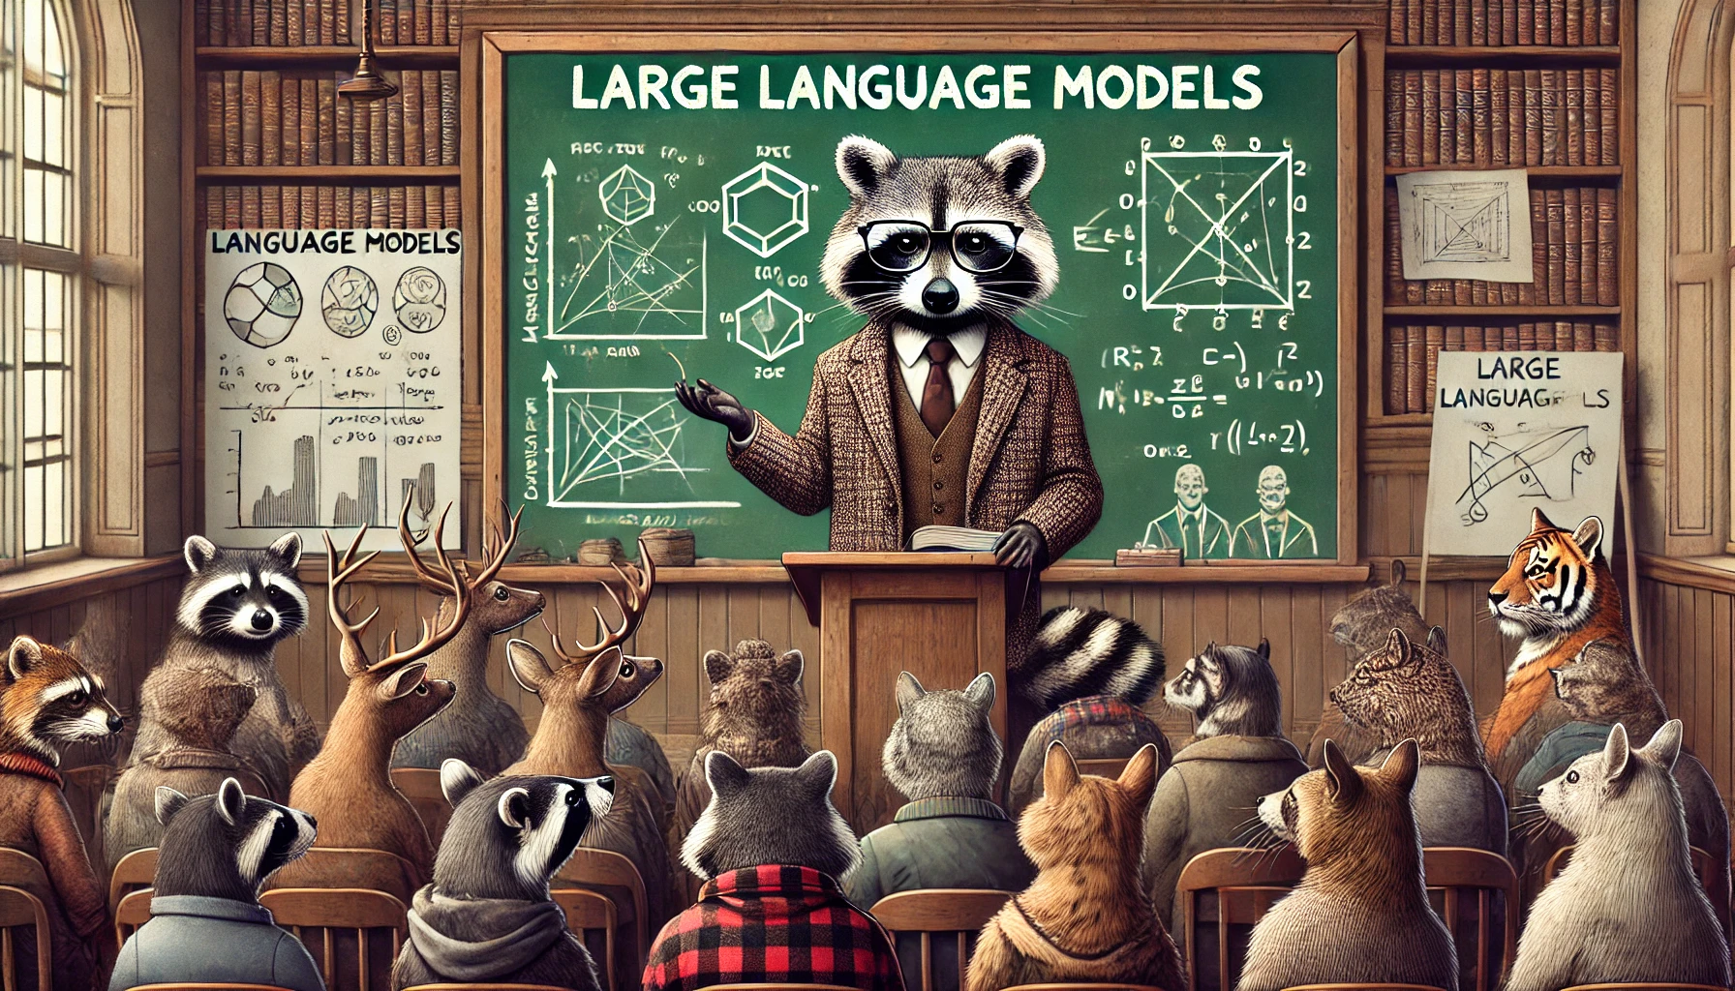
AI and Large Language Models
October 2024
Accelerate Programme for Scientific Discovery
Notes:
Thank you everybody for coming out today.

Slide 2
Welcome!
About the course
Introduction to LLMs and how they work
What is available?
How to use them
Code and slides available on:
Accelerate Science GitHub repo

Slide 3
Today's Schedule
Introduction to the Accelerate Science Programme
Introduction to LLMs
BREAK
Augmenting LLMs
Finetuning
Prompting
LUNCH
Small language models
Quantization
Data Ethics
BREAK
What’s out there?
Popular models
APIs
No Code
Notes:
First, an introduction to the Accelerate programme.
Introduction to LLMs –
- how do they work?
- how are they trained? Pretraining.
- what can we use them for.
- Caveats and popular opinion
What’s out there:
- Where can you get models from?
- What does OpenAI have on offer?
- Open source vs closed source.
- No code solutions
Fine-tuning and quantization
- Methods of fine-tuning
- RAG
- Instruction tuning
- Other tasks
APIs
– How to use the HuggingFace API.
- How to use the OpenAI API.

Slide 4
Accelerate Science Programme
"Accelerate Science pursues research at the interface of AI and the sciences, generating new scientific insights and developing AI methods that can be deployed to advance scientific knowledge."
Notes:
A brief overview of the Accelerate program.
Essentially, our driving goal is to help researchers use AI in their research. It says here that we pursue research at the interface of AI and Science, and you might think that this is limited to the typical STEM subjects, but actually it isn’t. We’re finding more and more that researchers from the Humanities want to utilize machine learning methods, and we’re having to reassess what we think of as traditional science.
We are ultimately here to facilitate this process of integrating AI into research.
Just a brief about us:

Slide 5
Accelerate Science Programme
LLM Workshop Goals
We want to:
Support researchers across the university to use AI – that's LLMs in this group.
Better understand the challenges that researchers face.
Identify what training courses or software resources we might want the Accelerate Science Programme to create.
Including shared code
Start to build a community of like-minded researchers across the university.
Notes:
At the end of this course, you’ll have the opportunity to provide us with feedback, which is very important to us. If you could take the time to fill it out, then we really would appreciate it.

Slide 6
Introduction to LLMs

Slide 7
Introduction to LLMs
Overview
What is a large language model?
How do they work?
How are they trained?
But first…
What do you know about LLMs…?
Notes:
We’re going to cover these things in the first section. But first I would really like to know what you all know about LLMs. In front of you, you will find some paper, and pens. If you could divide into groups and try and answer the following questions:

Slide 8
Introduction to LLMs
What do you know about LLMs…?
How do they work?
Can you name any?
What can you use them for?
What are potential problems?
What Can YOU potentially use them for?
Notes:
Take about 15 minutes.

Slide 9
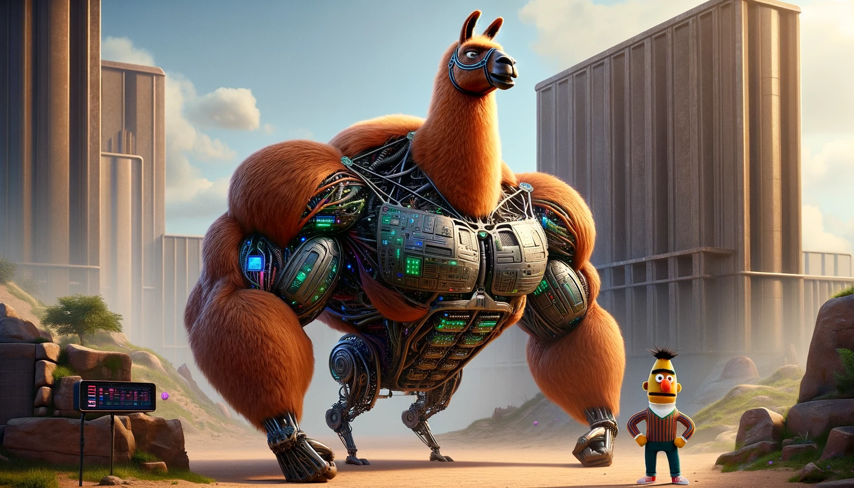

What is a Large Language Model?
What is a large language model?
Notes:
LLMs come in all shapes and sizes. Here we have Llama, one of the biggest open source models currently available, and on the right is BERT, one of the early language models. I really love this image, because even though there is this giant hulking gorilla-like Llama in the background, you still get the impression that it's actually Bert that's in charge in this image.
Although the architectures are quite different in terms of size, detail, components, and task, they both use the same fundamental building blocks. Before we really get into the details, I just want to take some time to define some common terms, just so we’re all on the same page.

Slide 10
Introduction to LLMs
First, some definitions…
Model The thing you train and use to generate text.
Architecture The high-level structure of the model.
Parameters (or weights) The internal knobs and dials that get altered during the course of training.
Context The input to the LLM.
Embedding A high-dimensional representation of text.
Token The smallest unit of text fed into a model.
Pretraining The first stage of training the LLM, and usually the most expensive.
Finetuning Training the LLM to do a particular task.
Inference The act of calling the model for text generation.
Quantization Reducing the size of a model.
Source The availability of the model (can be open or closed).
Modality Defined by the type of data the model is trained on (e.g. text or images).
API (Application Programming Interface) The means by which you can interact with a model.
Notes:
Here are some definitions, so that we’re all on the same page.
Model The thing you train and use to generate text. It is the combination of an architecture – a collection of neurons – and the weights – the connection strengths between those neurons.
Architecture The structure of the model. We talk about things like encoders and decoders, the numbers of layers, residual connections. This can be high-level, or it can be quite low-level (number of embedding dimensions for example)
Parameters (or weights) The internal knobs and dials that get altered during the course of training. They are typically the connection strengths between artificial “neurons”. Smaller models like BERT will have a few hundred million parameters, but the big ones, like Llama, might have billions or even trillions…
Context The input to the LLM. An example might be, suppose want to do masked token prediction. This would be something like “The <MASK> sat on the mat”, the context in this case is exactly that: “The <MASK> sat on the mat”. If you want to do next token prediction you might have “The cat sat on the”, and the context is ”The cat sat on the”. In the context of LLMs like ChatGPT, the context is also information that you give the model before your actual prompt.
Embedding A high-dimensional representation of text.
Token The broken up components of a piece of text, leading to an encoding of that text. You can’t feed text into a large language model. Text is a particular datatype called a string, and machine learning models don’t understand strings, they only understand numbers, which we call ints and floats (which we’ll get into when we talk about quantization later). A really simple example of how to tokenize text is to have a lookup table. The first word in the dictionary, (maybe Aardvark?), would correspond to the number 1. We also have a number of ”special tokens” which encode things like the start of the end of a sentence.
Pretraining The first stage of training the LLM, and usually the most expensive.
Finetuning Training the LLM to do a particular task.
Inference The act of calling the model for text generation. So the model has been trained, and you are using it to do the task that you want.
Quantization Reducing the size of a model. There are many reasons why you might want to reduce the size of a model – you might want faster inference times, or you might want to reduce the memory footprint.
Source The availability of the model (can be open or closed). In addition, a company might release the weights, but give no information about the training data. Or they might release the architecture…but not the weights.
Modality Defined by the type of data the model is trained on (e.g. text or images). Some models are multi-model, like GPT4.
API (Application Programming Interface) The means by which you can interact with a model. A company like OpenAI, which train a model, and then host it on a server

Slide 11
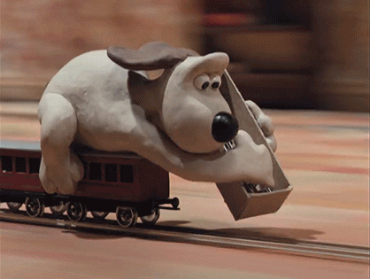
What are LLMs?
LLMs are conditioned on a massive amount of text.
Given some input tokens, and given what we know from the training data, what is the most likely next token?
An analogy…
https://www.youtube.com/watch?v=zjkBMFhNj_g
Notes:
Summary.
Andrej Karpathy has an excellent analogy where you can think of LLMs as like that scene from Wallace and gromit where he’s just laying down tracks. He’s not looking into the future, he’s not thinking about what he’s doing, he’s just laying down tracks so as not to derail the train.

Slide 12
What is a large language model?
A language model is a high-parameter model that is trained on massive amounts of text with the end goal of some kind of text prediction or generation.
Not all language models have the same architecture
Not all language models are built for next-token prediction
GPT is a next token predictor
BERT is a masked-language model
Not all language models are chatbots.
Notes:
The easiest definition of an LLM is simply a high parameter model typically greater than hundreds of millions, trained on massive amounts of text to do some kind of text generation. Notice that I’ve said ”some kind of text prediction” because not all language models are built to do the same task. For example, GPT models are next token predictors, but BERT is a masked-language model. These tasks are also linked to their architecture types - decoder only, encoder only, etc.
Not all language models are chatbots – ChatGPT was not initially optimized for chatting. For ChatGPT to function in the way that it currently does, it had to be trained on another task.

Slide 13
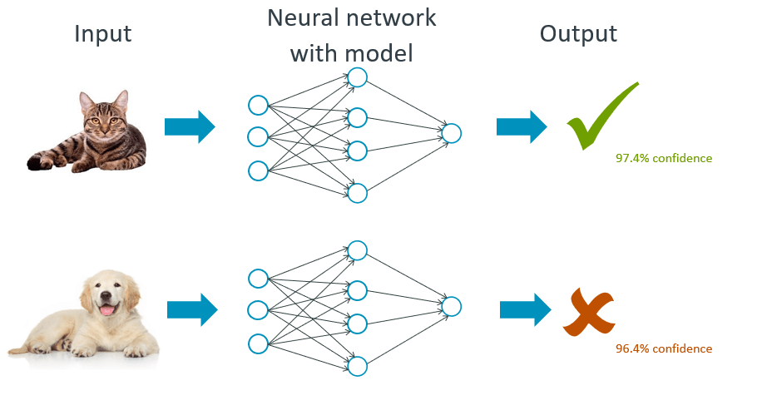
What is a model?
A normal neural network
Picture goes in
Pixel values propagate through the weights of the network
Network outputs either “cat” or “dog”
Update the weights of the network based on how wrong the prediction is
Do many times
Notes:
This is a normal neural network

Slide 14
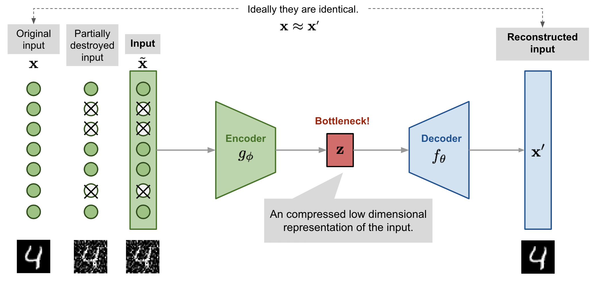
What is a large language model?
Encoder vs Decoder
Notes:
I can now sample from this latent distribution and generate NEW images. I cannot generate new images from the simply encodings alone.
BERT is an encoder only model – it’s job is to construct meaningful contextual representations of text. We will talk about BERT later.

Slide 15
Tokenization
the cat sat on the mat
Light reflects off the page and enters your eyes.
Your retina converts this light into electrical signals.
These signals are preprocessed in your visual cortex, identifying shapes and patterns.
The information travels through various layers of your brain, each extracting different levels of meaning.
Your language centers parse the sentence structure and vocabulary.
Your memory centers activate, linking these words to past experiences and knowledge.
Finally, your imagination constructs a vivid mental image based on all this information.

Slide 16

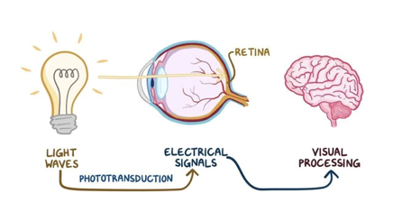
Tokenization
the cat sat on the mat

Slide 17

How do LLMs do this?
Here is a Llama…

Slide 18
Tokenization
The machine starts from scratch
text = "The cat sat on the mat."
tokens = text.split()
print(tokens)
# Output: ['The', 'cat', 'sat', 'on', 'the', 'mat.’]

Slide 19
Tokenization
The machine starts from scratch
# Build vocabulary
vocab = sorted(set(tokens))
# Create token to index mapping
token_to_index = {token: index for index, token in enumerate(vocab)}
# Create index to token mapping
index_to_token = {index: token for token, index in token_to_index.items()}
print(token_to_index)
# Output: {'cat': 0, 'mat': 1, 'on': 2, 'sat': 3, 'the': 4}
# Convert tokens to indices
indices = [token_to_index[token] for token in tokens]
print(indices)
# Output: [4, 0, 3, 2, 4, 1]

Slide 20
Tokenization
Types of tokenization
Word tokenization
Character tokenization
text = "The cat sat on the mat.”
tokens = list(text) print(tokens)
# Output: ['T', 'h', 'e', ' ', 'c', 'a', 't', ' ', 's', 'a', 't', ' ', 'o', 'n', ' ', 't', 'h', 'e', ' ', 'm', 'a', 't', '.']
Subword tokenization
BPE

Slide 21
Tokenization
Subword tokenization
BPE recursively merges the most frequently occuring pairs of consecutive bytes within a corpus of text.
Suppose we have the following sentence:
"the cat sat on the mat”
We begin by splitting the sentence into words:
['the', 'cat', 'sat', 'on', 'the', 'mat']

Slide 22
Tokenization
Subword tokenization
We come up with a starting vocabulary:
['h', 'n', 'm', 'o', 't', 'e', 'a', 's', ‘c’]
We then look at pairs of characters.
For example, the pair 'at' occurs 3 times in this sentence.
Similarly, 'th' and 'he' occur twice, but combinations like 'ca', 'ma', and 'on' only occur once.
We build up a frequency map:
{'at' : 3, 'th' : 2, 'he' : 2, 'ca' : 1, ... etc. }

Slide 23
Tokenization
Subword tokenization
We then add the most frequent pairs of characters into the vocabulary, so it now becomes:
['h', 'n', 'm', 'o', 't', 'e', 'a', 's', 'c', 'at’]
We repeat the process, but we are not considering the combinations that also include the 'at' token. So when we break down the sentence into tokens it becomes:
['t', 'h', 'e', 'c', 'at', 's', 'at', 'o', 'n', 't', 'h', 'e', 'm', 'at’]
Now we look for frequent combinations again, and we have:
{'th' : 2, 'he' : 2, 'cat' : 1, 'sat' : 1, 'mat' : 1, ... etc. }
We add 'th' and 'he' to the vocabulary:
['h', 'n', 'm', 'o', 't', 'e', 'a', 's', 'c', 'at', 'th', 'he']

Slide 24
Tokenization
Subword tokenization
If we now tokenise the sentence again, it will be become:
['th', 'e', 'c', 'at', 's', 'at', 'o', 'n', 'th', 'e', 'm', 'at’]
You might notice the overlap of 'th' and 'he'. BPE favours firstly, longer tokens, and secondly, earlier merges take precedence over later ones.
Looking for frequent combinations, we have:
{'the' : 2, 'cat' : 1, 'sat' : 1, etc. }
And now 'the' can get added to the vocabulary.

Slide 25
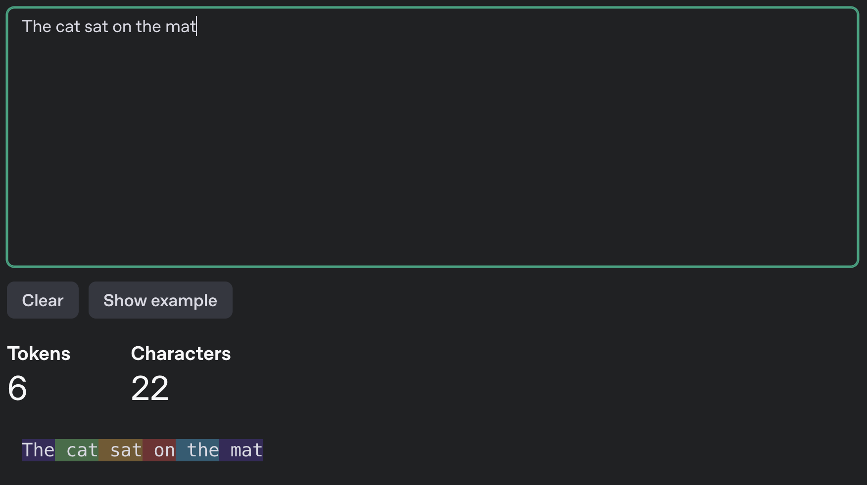

Slide 26
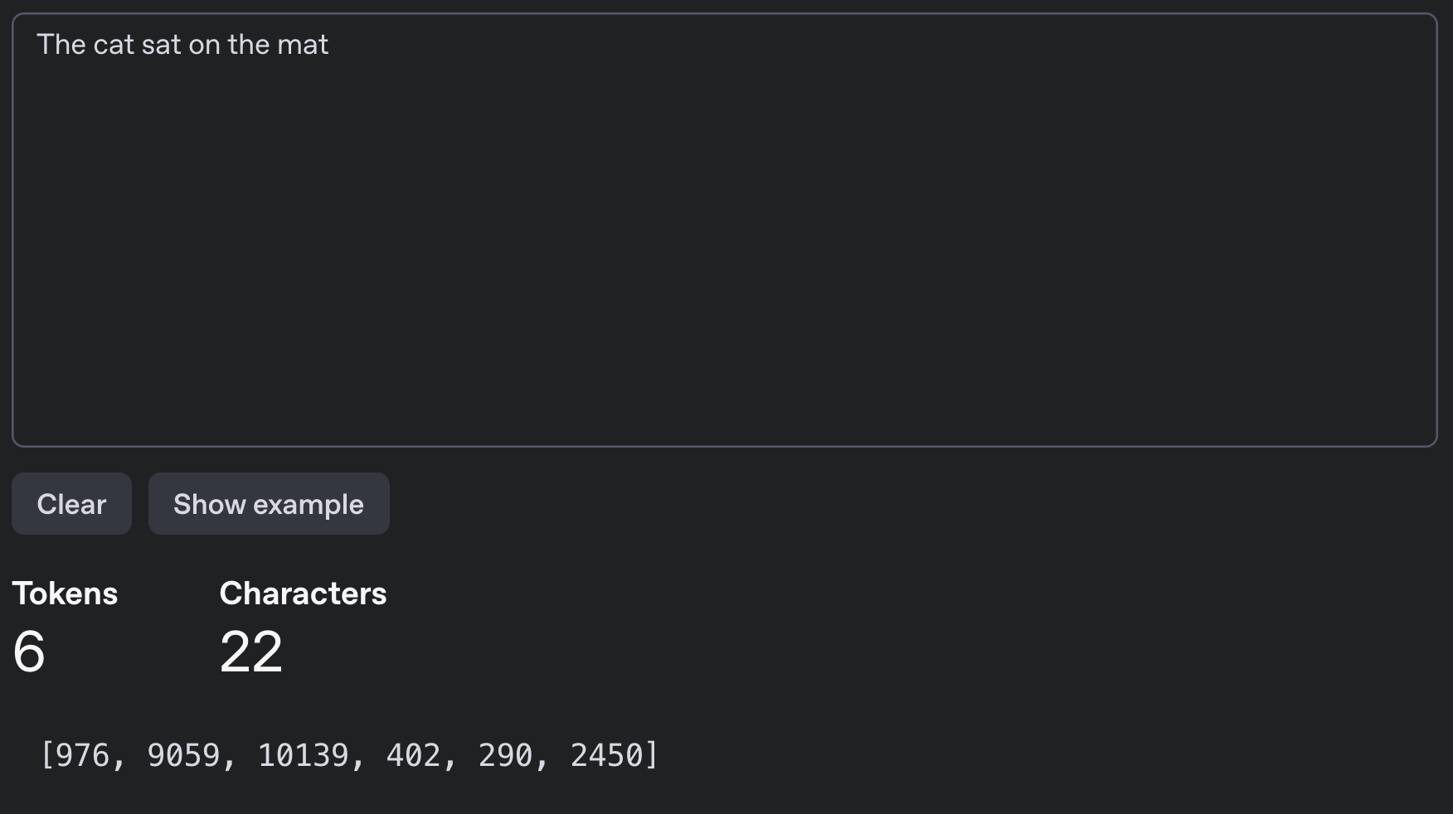

Slide 27
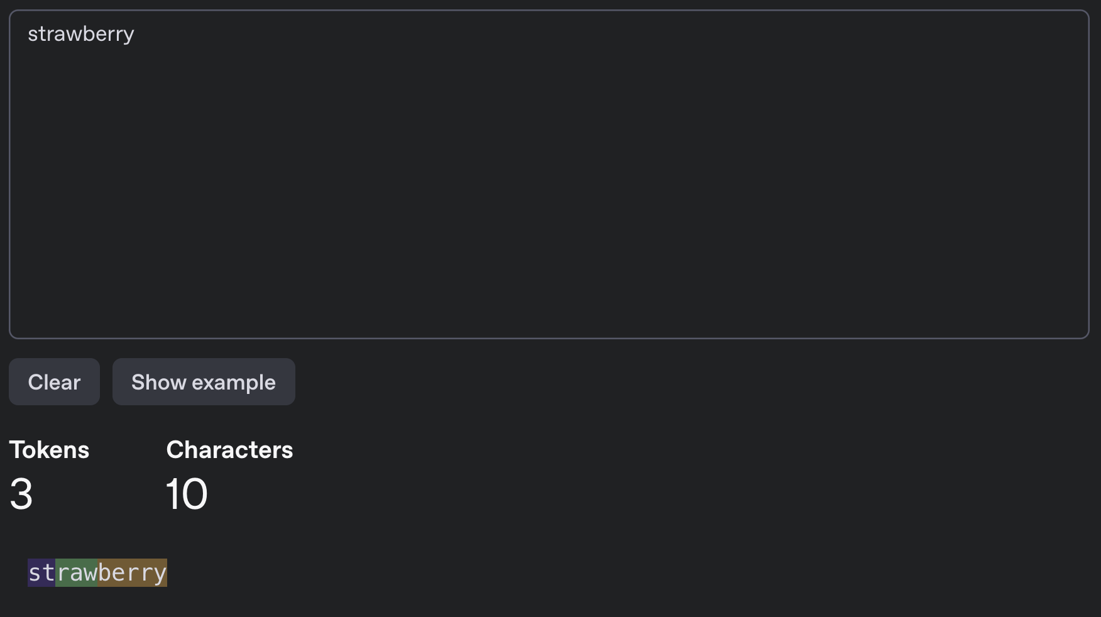

Slide 28
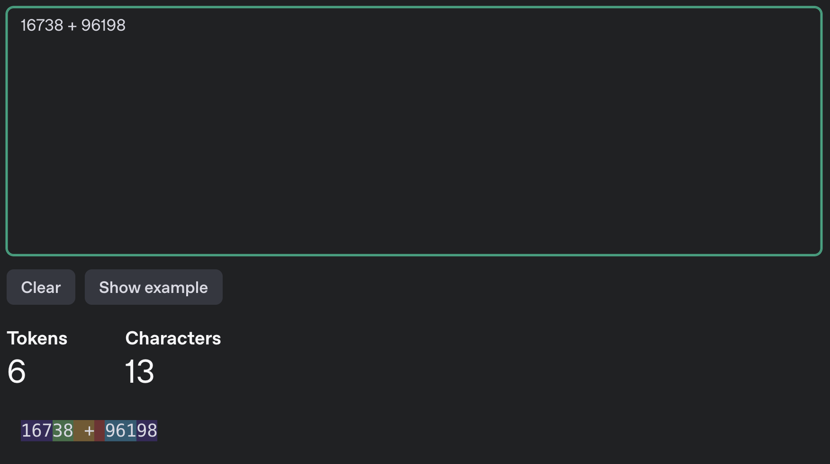

Slide 29
Embeddings
Suppose I have the following corpus and tokenizer…
[
“the cat sat on the mat”,
“the dog sat on the mat”,
“the cat sat on the dog”,
]
{‘the’ : 0, ‘cat’ : 1, ‘sat’ : 2, ‘on’ : 3, ‘mat’ : 4, ‘dog’ : 5}

Slide 30
Embeddings
We can use one-hot encodings…
'the’ : [1, 0, 0, 0, 0, 0]
'cat’ : [0, 1, 0, 0, 0, 0]
'sat’ : [0, 0, 1, 0, 0, 0]
'on’ : [0, 0, 0, 1, 0, 0]
'mat' : [0, 0, 0, 0, 1, 0]
'dog' : [0, 0, 0, 0, 0, 1]
1 | 0 | 0 | 0 | 0 | 0
0 | 1 | 0 | 0 | 0 | 0
0 | 0 | 1 | 0 | 0 | 0
0 | 0 | 0 | 1 | 0 | 0
1 | 0 | 0 | 0 | 0 | 0
0 | 0 | 0 | 0 | 1 | 0

Slide 31
Embeddings
Problems!
Very sparse vectors
High dimensionality
No semantic meaning captured

Slide 32
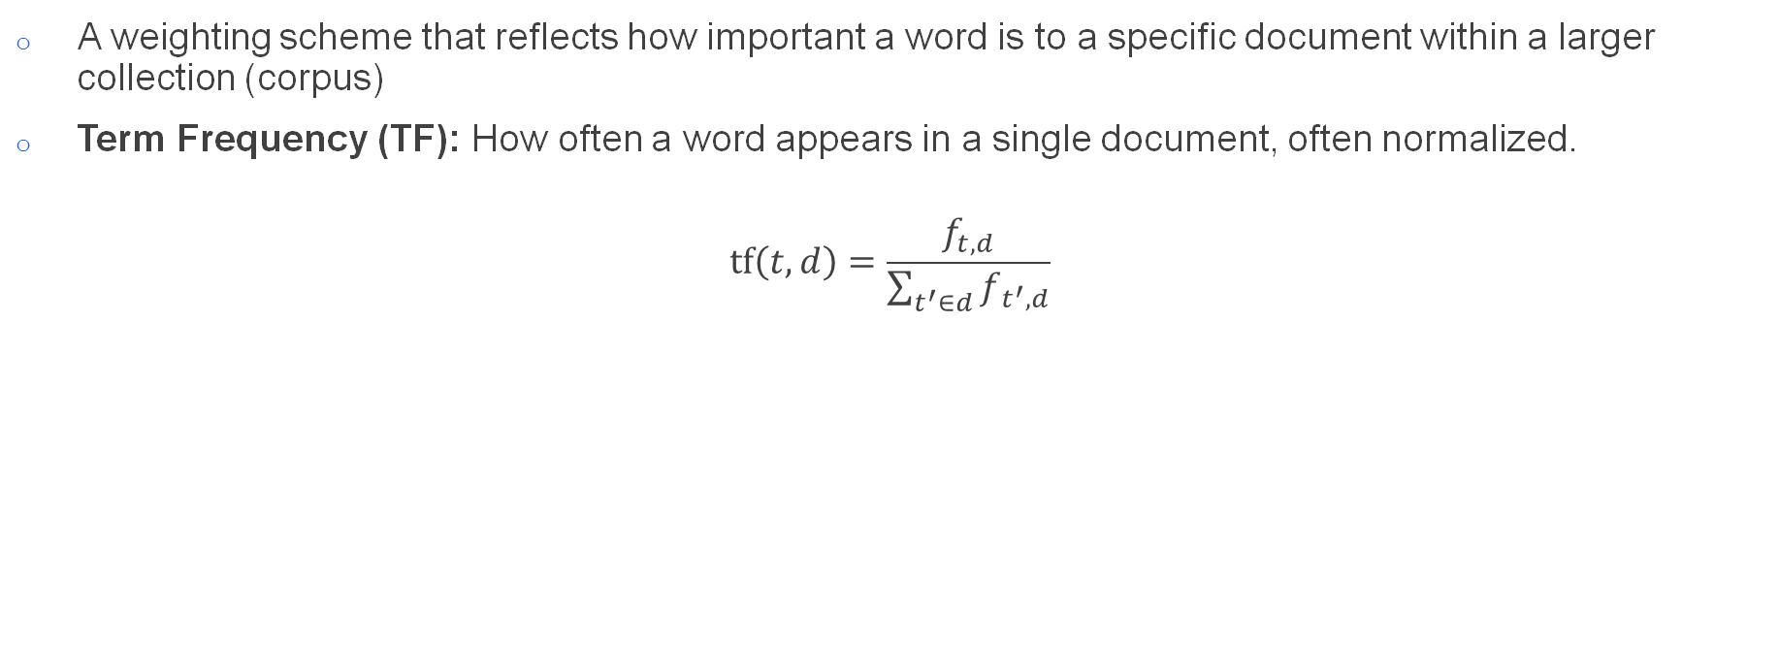
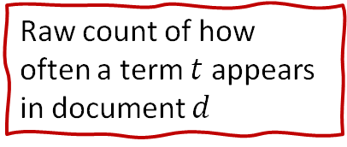
A weighting scheme that reflects how important a word is to a specific document within a larger collection (corpus)
Term Frequency (TF): How often a word appears in a single document, often normalized.
$$tf\left(t, d\right)=\frac{f_{t,d}}{\sum_{t^{′}∈d}{f_{t^{′},d}}}$$
Embeddings
Term Frequency–Inverse Document Frequency (TF-IDF)
The total number of terms in the document
Raw count of how often a term $t$ appears in document $d$
 | d0 | d1 | d2
the | 0.333 | 0.333 | 0.333
cat | 0.167 | 0.000 | 0.167
sat | 0.167 | 0.167 | 0.167
on | 0.167 | 0.167 | 0.167
mat | 0.167 | 0.167 | 0.000
dog | 0.000 | 0.167 | 0.167

Slide 33
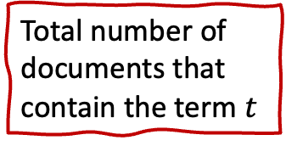
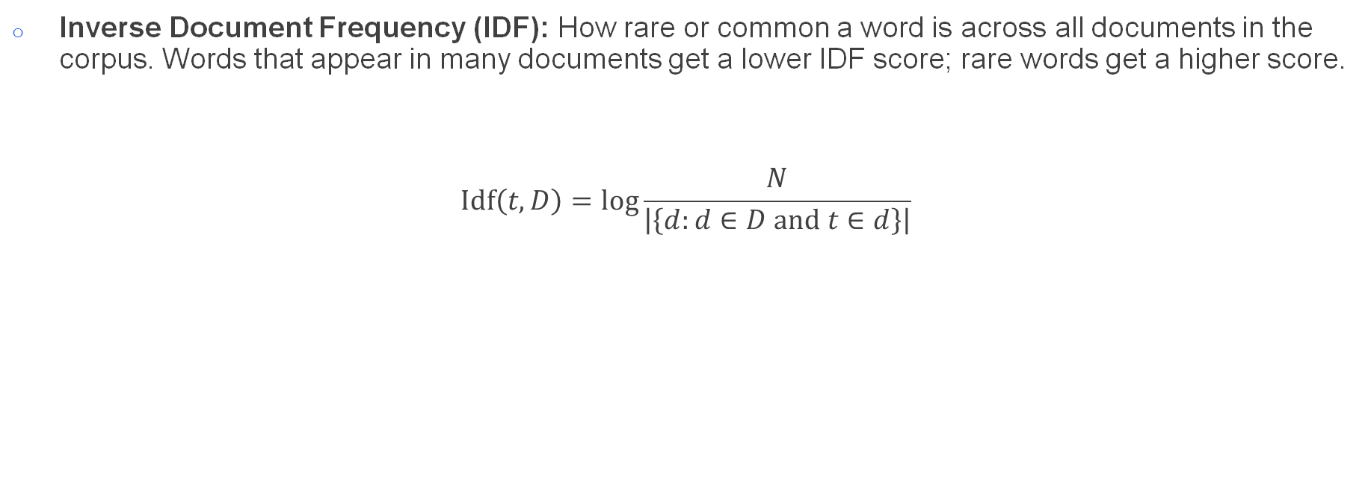
Embeddings
Term Frequency–Inverse Document Frequency (TF-IDF)
Inverse Document Frequency (IDF): How rare or common a word is across all documents in the corpus. Words that appear in many documents get a lower IDF score; rare words get a higher score.
$$Idf\left(t, D\right)=\log{\frac{N}{\left|\left\{d:d∈D and t∈d\right\}\right|}}$$
Total number of documents
Total number of documents that contain the term $t$
IDF('the') = log(3 / 3) = log(1) = 0
IDF('cat') = log(3 / 2) = log(1.5) ≈ 0.405 IDF('sat') = log(3 / 3) = log(1) = 0
IDF ('on') = log(3 / 3) = log(1) = 0
IDF('mat') = log(3 / 2) = log(1.5) ≈ 0.405 IDF('dog') = log(3 / 2) = log(1.5) ≈ 0.405

Slide 34
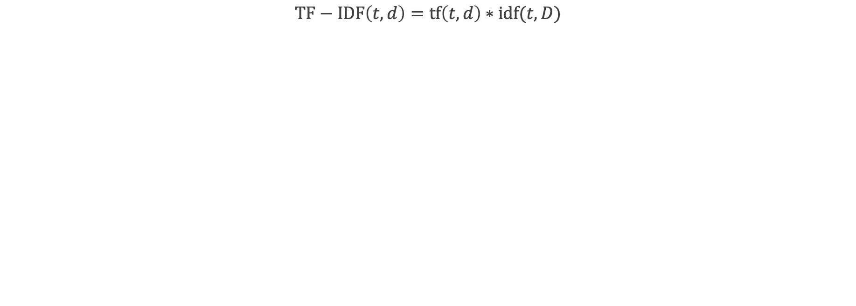
Embeddings
Term Frequency–Inverse Document Frequency (TF-IDF)
$$TF−IDF\left(t, d\right)=tf\left(t,d\right)∗idf(t,D)$$
 | d0 | d1 | d2
the | 0.000 | 0.000 | 0.000
cat | 0.0675 | 0.000 | 0.0675
sat | 0.000 | 0.000 | 0.000
on | 0.000 | 0.000 | 0.000
mat | 0.0675 | 0.0675 | 0.000
dog | 0.000 | 0.0675 | 0.0675

Slide 35
Embeddings
Term Frequency–Inverse Document Frequency (TF-IDF)
Each “document” is represented as a vector of TF-IDF scores:
“the cat sat on the mat” : [0, 0.0675, 0, 0, 0.0675, 0]
Reflect term importance, not just presence
Still sparse
Still high-dimensional
Stil no semantic meaning

Slide 36
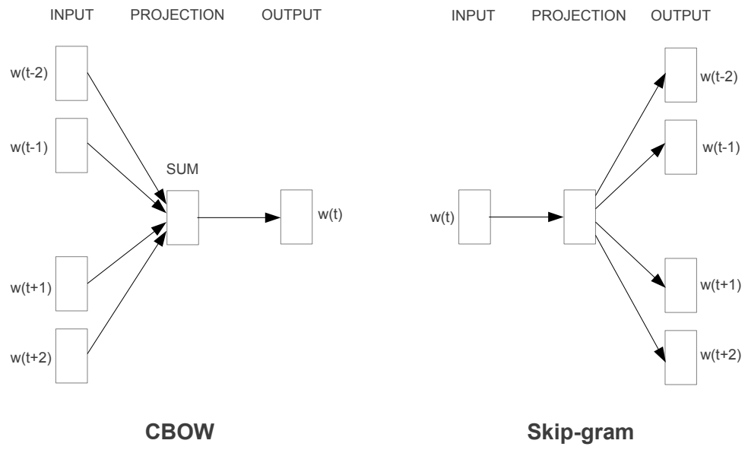
Embeddings
word2vec
[
“the cat sat on the mat”,
“the dog sat on the mat”,
“the cat sat on the dog”,
]
“cat” and “dog” appear to be used in a similar way in the first 2 sentences
Maybe cat and dog are semantically similar?
Use a neural network to predict words!

Slide 37
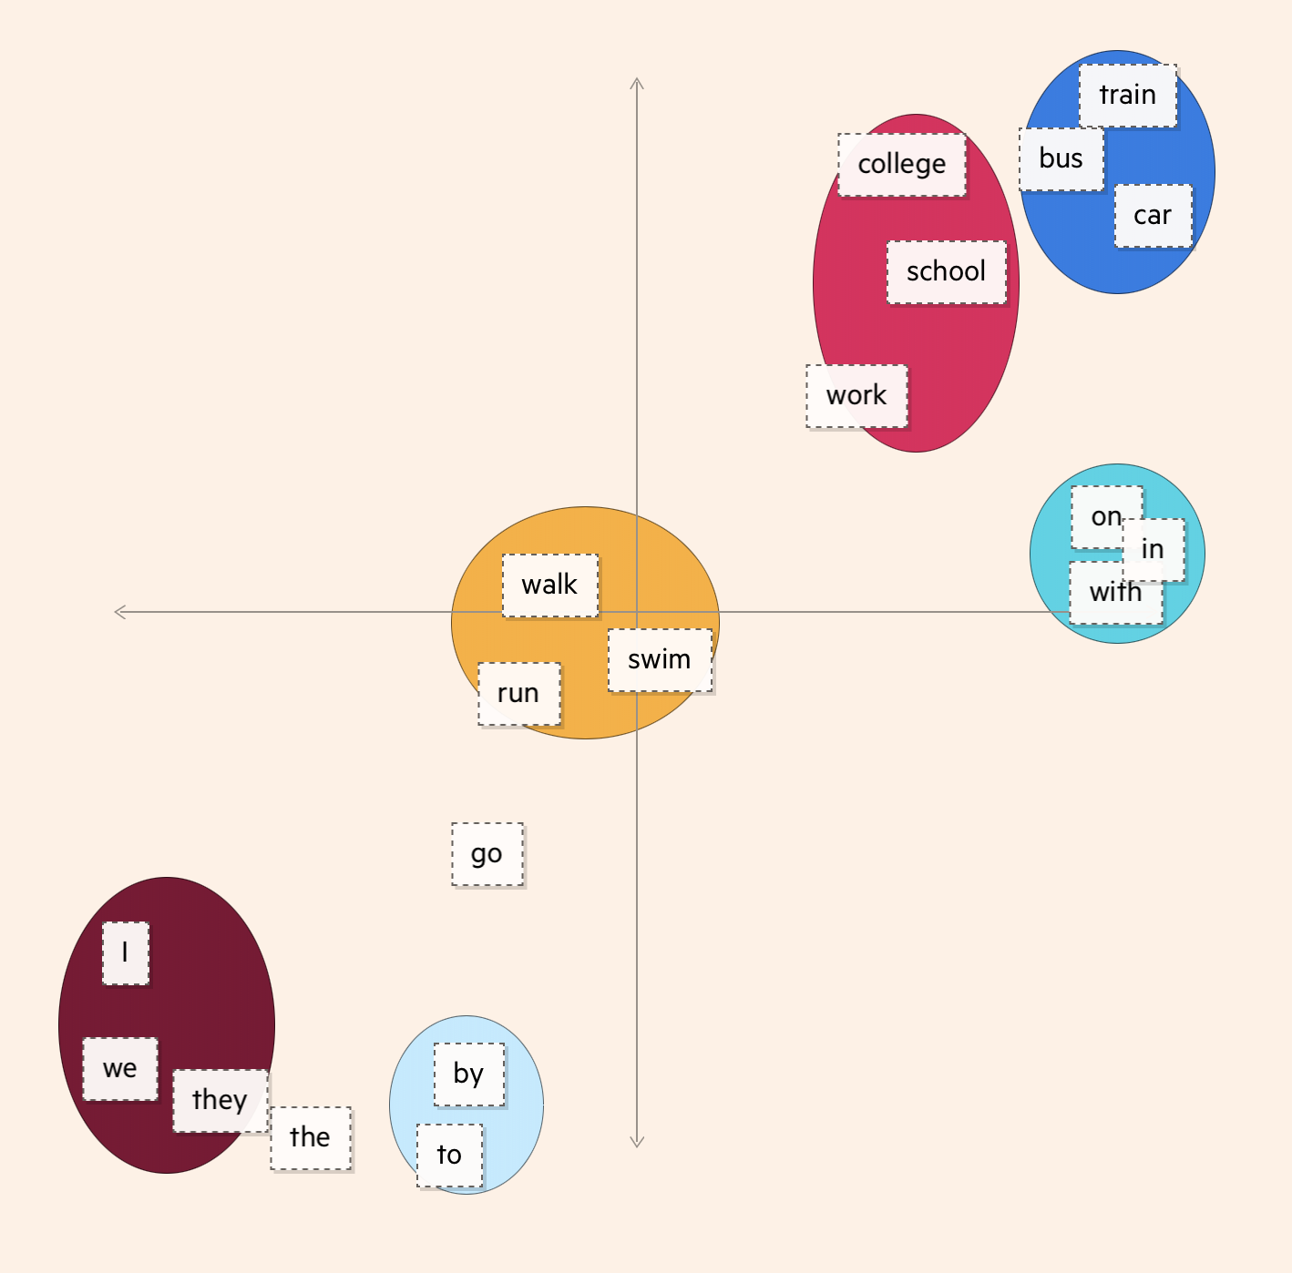
Embeddings
Embeddings are vectors (lists of numbers)
https://ig.ft.com/generative-ai/
There are a number of different types of embeddings:
Learned
Positional
Combinations
Notes:
One of the core components to understanding LLMs is the idea of an embedding. This is the act of taking a vector, so an array of numbers and transforming it into another vector, but with a different number of dimensions.
A simple example would be a positional embedding. So you might assign a number to each entry in the vector based on it's position in the array.

Slide 38
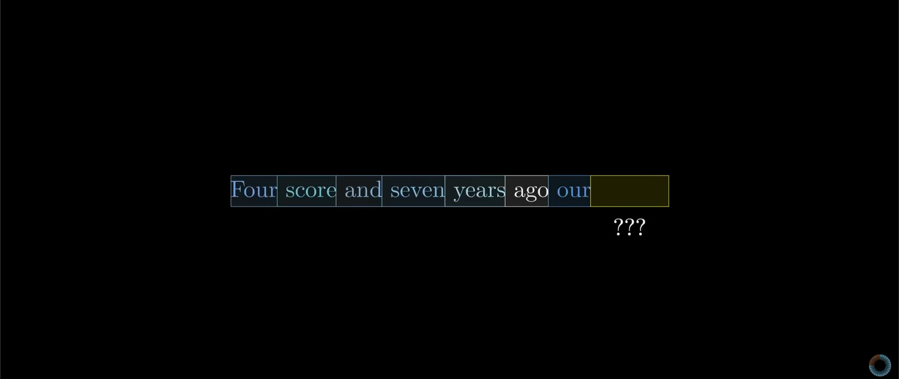
Embeddings
Shameless “borrowed” from the excellent 3Blue1Brown video series: https://www.youtube.com/watch?v=eMlx5fFNoYc
Notes:
The important thing here is that direction in this space can encode semantic meaning.
The core goal of a transformer, is to adjust these embeddings, such that they do not simply encode a single word into a number, but instead encode a more sophisticated contextual meaning.
For example, we would want the contextual embedding of “bark” like a dog, to be very different to that for “bark” on a tree.
Attention Blocks calculate: what do I need to add to the static embedding, in order to move it to the context specific embedding?
Let’s have a look at how this works…

Slide 39
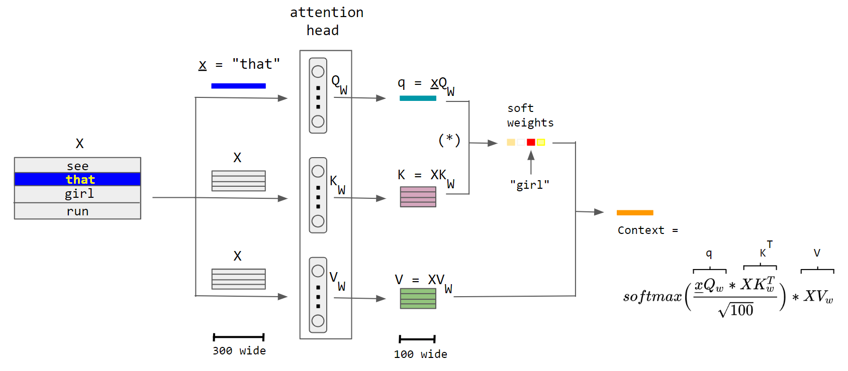
How do they work?
The attention mechanism
https://commons.wikimedia.org/wiki/File:Attention-qkv.png
Notes:
#### Attention Heads
First you have some input text presented in the form of tokens. This is the _context_. The goal is as follows: given the context of length $n$, what is the $n+1$ token.
We take the sequence of tokens, and embedded them into a high-dimensional space. Each token in the context has its own embedding: $E_1, E_2, ..., E_n$.
These embeddings are then multipled by three weight matrices: $W_Q$, $W_K$, and $W_V$, to give the query, key, and value vectors: $Q_i$, $K_i$, and $V_i$ respectively.
Take an example of a noun that might appear in a sentence:
```python
see that girl run
```
In this case, the noun is `girl`. We would hope that the query matrix might map embeddings of nouns into certain directions that might encode the idea of looking for associated verbs in other positions of the sentence.
You can think of the query as each token asking questions of every other word, and the key giving the answer to that word.
Going back to our girl example, the question is: "Are there any words that describe what that girl is doing?", and the embedding for `run` answers that question.
What does that actually look like though? To measure how well a key matches a query, you take a dot product between each Q and each K.
We would actually like these values to form a probability distribution, so we apply a softmax function after normalizing the token relevance by $\sqrt{d}$ in order to control gradients.
Now we need to update the original embeddings, updated the words to indicate how they were relevant to other words. We use the value weight matrix. This is like saying: if this word is relevant to adjusting the meaning of some other word, what do I need to add to the other word?
So in the example above looking at nouns and verbs: _what do I need to add to the concept of girl in order to get the concept of a running girl?
In the simple example above, we can focus on the word `that`. Attention is essentially the process of finding which words correlate highly with `that`. One attention layer may correlate `girl` with `that`, since `that` is the pronoun associated with `girl`. However, another attention layer might correlate `run` highly with `girl`, since this particular layer may be on the look out for verbs that describe the subject of the sentence.
This is somewhat analogous to learning convolutional layers in a vision model. We can hard-code certain feature detection kernel into the model - one for horizontal edges, one for vertical edges, etc. - but it is far more effective to let the model learn these kernels. Similarly, we can think of different attention layers as learning different "features" of the language that it has been fed.
Just as with vision models, which typically learn different features of the images they are trained on, different heads and layers of a language model tend to specialise in capturing different information. In particular, lower layers might capture more local, syntactic features, while higher layers might capture more global, semantic relationships.
We aren’t going to focus too much on this, but the core idea behind all of the models that you see and hear about today, is this – self attention.
The example sentence we use here is “see that girl run”, and we focus in particular on the word “that”, but in reality, this all happens simultaneously.
Firstly, the word is embedded in a high-dimensional space, in this case a 300-dimensional space. Every word is embedded in this high dimensional space. Sometimes the nature of this embedding is complicated – there might be a component that is learned, there might also be a component that is hard-coded, for example to capture the positional information of the words (i.e. where in the sentence the word appears).
The heart of attention are these three matrices: the Query, the Key, the Value.
This embedding is then multiplied by the Query matrix. At the same time, the sentence is multiplied by the Key and Value matrices. Don’t worry too much about the names of the matrices. These matrices might have 100 neurons, which means that you have matrices of size 300x100.
The query vector, here denoted by q, is compared to each word in the keys matrix. In this way, the model will find the most relevant word for the query. So in this case, the word “girl” should be the most relevant word for “that”. The result of this is passed through a softmax function. This function will produce a range of probabilities, summing to 1. In this case the vector will be the same size as the context vector. This is a probability distribution which will denote which word is the most importantly linked to the word “that”. This is scaled to control the variance, so that one word doesn’t dominate, because there might be multiple words that are important. The outcome of this is multiplied by the Value matrix, in order to amplify the most important signal and diminish the least important ones.
This is a lot of conceptual information, but really what you have to know is that it’s a bunch of matrix multiplications and it produces a probability distribution over the input context.

Slide 40
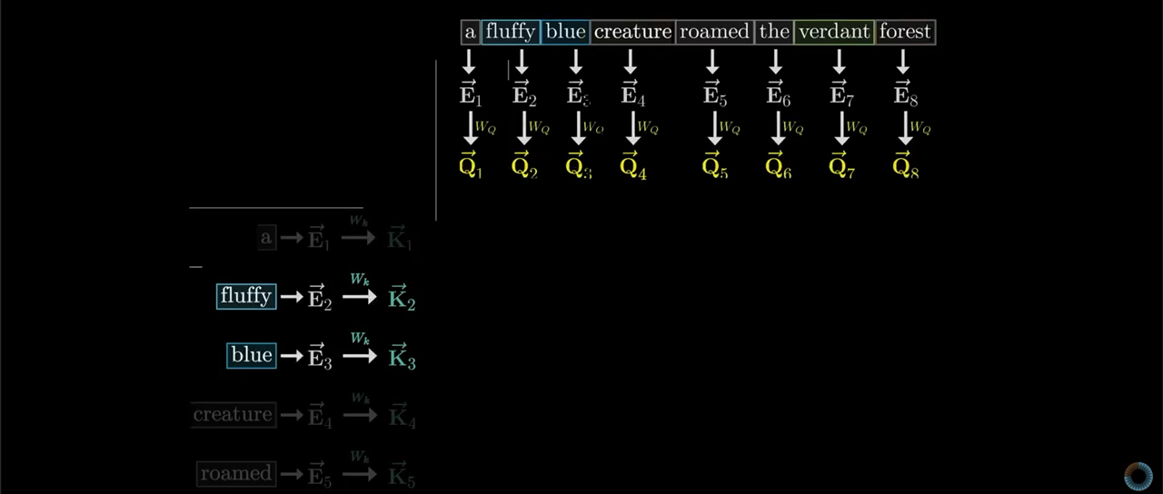
How do they work?
Notes:
You can think of the Query vector as the word girl asking questions of the surrounding tokens. The keys therefore are answering those queries, and the game is, see how closely my query matches my key. This gives a score of how relevant the other words are to updating the contextual meaning of every other word.
We want to then say, well ok, what probability should I assign to each word. In other words, I want a weight sum. So I’m not going to apply a softmax function across the columns. The Softmax function normalizes a bunch a values so that they all add up to 1.

Slide 41
How do they work?
The attention mechanism
https://commons.wikimedia.org/wiki/File:Attention-qkv.png
Notes:
Now what the V matrix does is says OK, you’ve given me a bunch of numbers which say how important each word is to every other word. But remember the goal is to adjust the embeddings in embedding space so as to represent the contextual information – i.e to shift the embedding away from the static embedding. The V matrix says, ”OK, so how much do I need to add?”

Slide 42
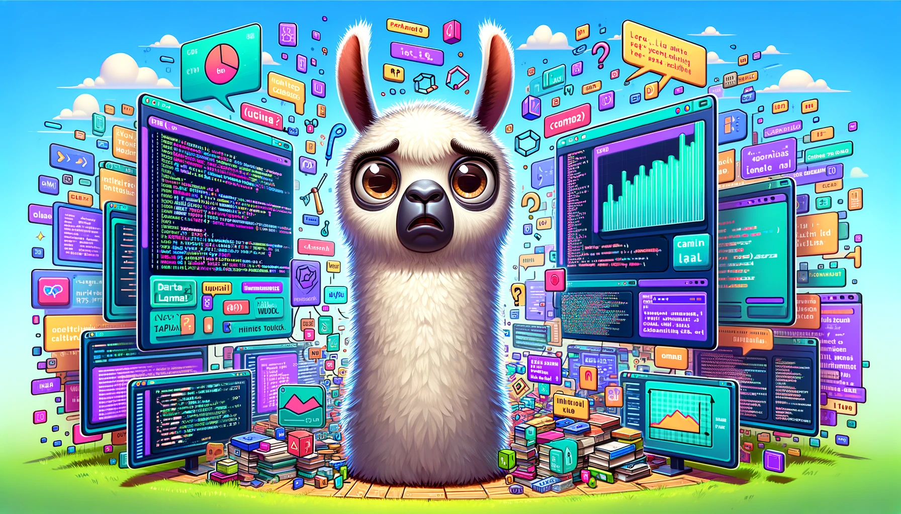
How are they trained?
But how are they trained…?
Notes:
Now, what happens when we want to train this to do next token prediction?

Slide 43
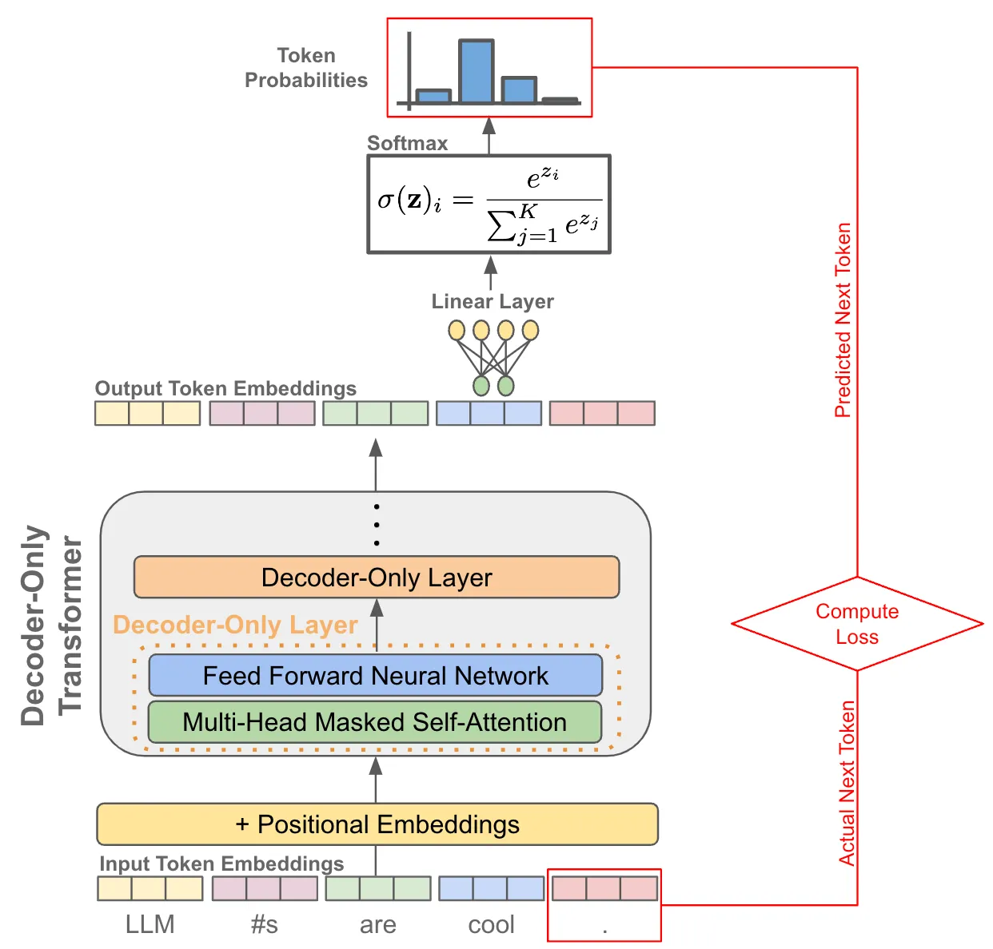
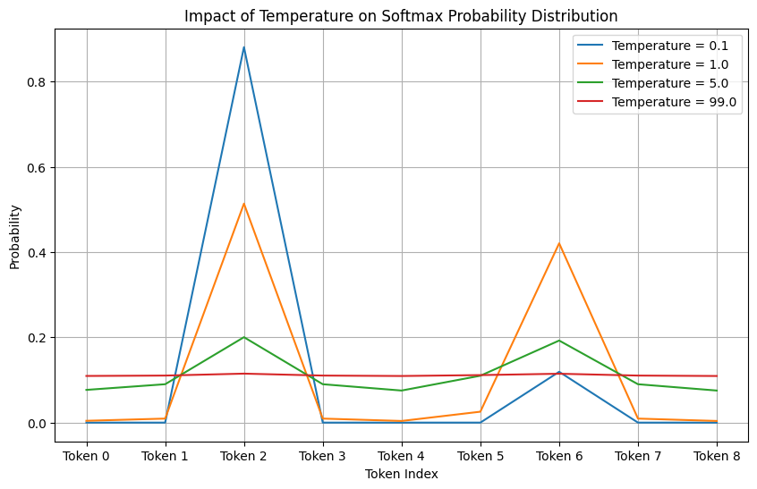
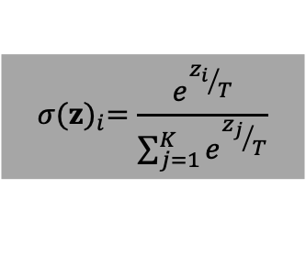
How are they trained?
We focus on next token prediction…
Take the outputs from the attention head.
Apply a linear layer to each embedding.
This produces a probability distribution over your token dictionary.
Compare this to the actual next token and adjust the internal weights.
Do this on ~10TB of text!
$$σ{(z)}_{i}=\frac{e^{{z_{i}}/T}}{\sum_{j=1}^{K}{e^{{z_{j}}/T}}}$$
# Example logits (e.g., attention scores)
logits = np.array([0.2, 1.0, 5.0, 1.0, 0.1, 2.0, 4.8, 1.0, 0.1])
https://medium.com/@akash.kesrwani99/understanding-next-token-prediction-concept-to-code-1st-part-7054dabda347
Notes:
Think about what we want to do now. If we want some kind of token prediction, then we need to ask: what is the most probable next token in this sequence? But to do that, we need to find probabilities of all tokens! So, the problem of next token prediction can be framed as ”Given the context, what is the most likely next token”.
We just take the outputs from the attention heads, and stuff them into linear layers. This will then output a probability distribution over the possible tokens. For example, if your tokens are just 200,000 words in a dictionary ranging from Aardvark to Zyzzyva, then you will have a 200,000 element long vector, where each entry is the probability of the next token being the one corresponding to that element’s corresponding token.
We now have a distribution which we can draw from. One possible strategy is to simply draw the token with the highest probability. We could pick the top 10 tokens and draw uniformly at random from those. There are many different strategies to draw from this distribution, and you’ll often see a parameter called the temperature of the model, which will dictate how random you want the drawing process to be. In fact, what that does is act directly on the Softmax function itself. When T is higher, more weight is given to the lower values. We then use Nucleus sampling to draw values from this. Typically, during training, T is fixed at 1.
We’ve looked in a little bit of detail at how they work, but essentially, LLMs are a series of matrix multiplications outputting a probability distribution, and the rest is just implementation details. That’s it.
The real issue is that you need a lot of text to do this well. Approximately 10TB worth of text to be precise.
So where does this training data come from?

Slide 44
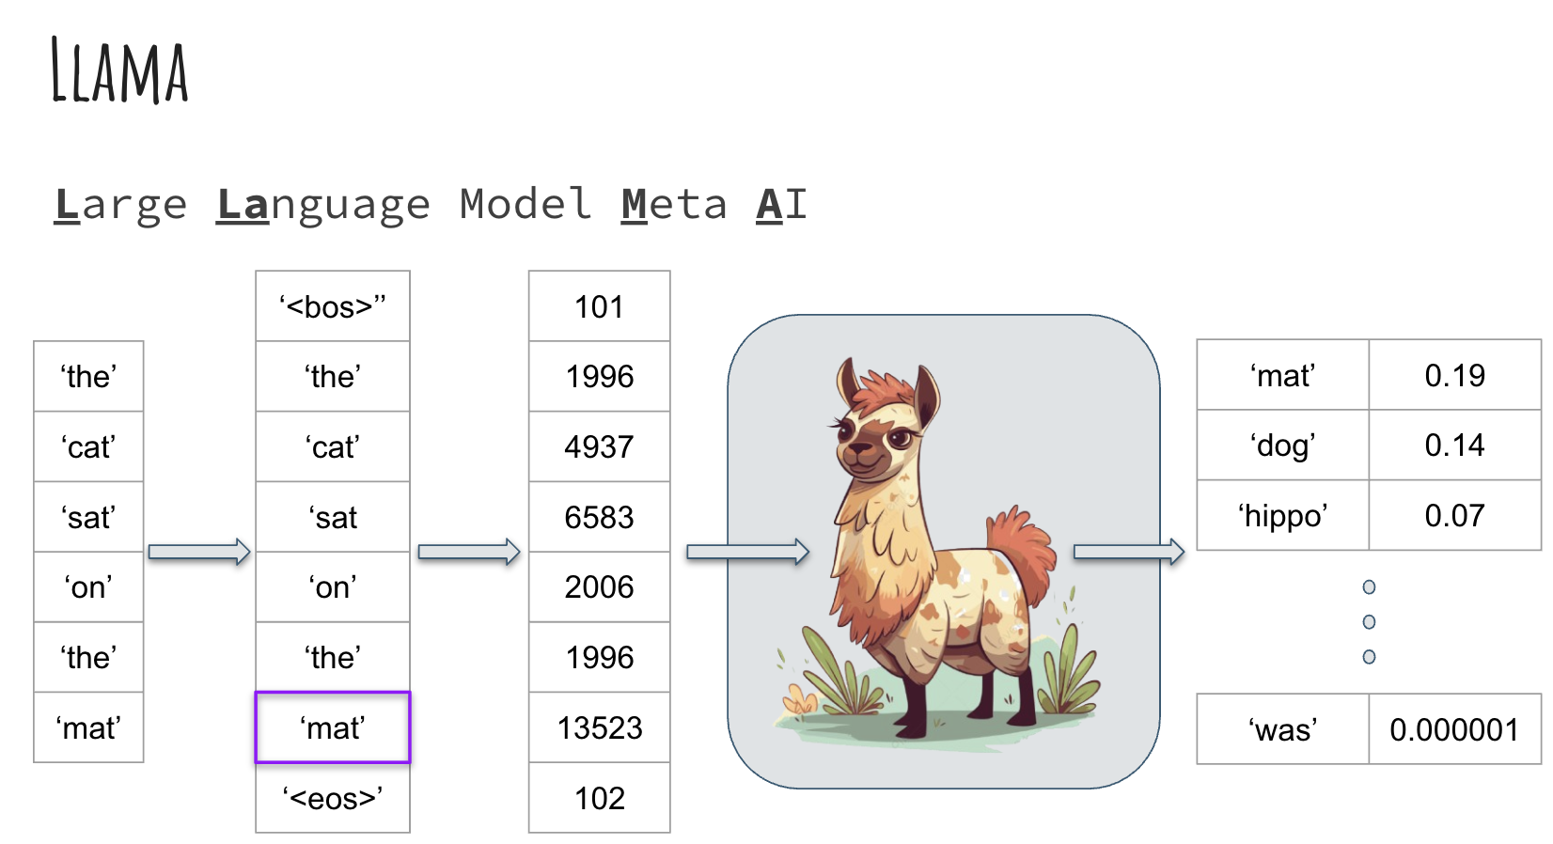

Slide 45
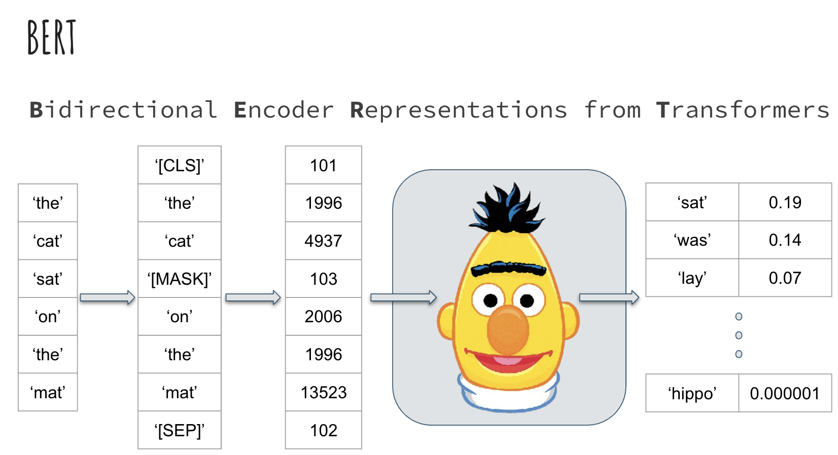

Slide 46

How are they trained?
Notes:
The Pile, a nearlyt 900GB text database.
- Common Crawl (46% is English, and every other language is below 6%). It includes copyrited materials
- Stack exchange,
- ArXiv
- GitHub
- PubMed
- Wikipedia
- YouTube subtitles and comments
- Reddit
If anyone has frequented the YouTube comment section at any point or reddit in general, you can see how problematic this might be. If anyone interacted with the earlier versions of GPT-3, it was really quite unconstrained. (back in September 2021)
For Llama-2 this required 6,000 A100s for 12 days, which would have cost about $2M (not including the cost of the A100s, which are about 15-20k USD apiece…).
But this is only a small part of the dataset. Llama was trained on 10TB of text and what we’ve got out of it, is for a 70B parameter model, which is about 140GB. So you can think of an LLM as a compression of the information that it was trained on, and in fact there is a correspondence between good compression and a good predictor.

Slide 47
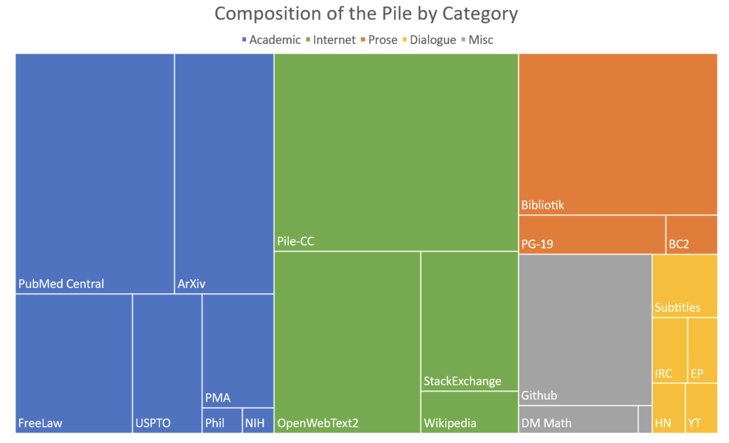
How are they trained?
Notes:
A good way to understand the scale of the training data is to consider the Bibliotik dataset. It is nearly 200k books. Think about how many books you’ve read in your life, and how long it would take to read 200k books. If you read one book per month, you would still read under 1000 books in your entire life. This dataset is about 100GiB and around 12% of The Pile. The pile is is around 900GiB. The size of the training data for Llama was 10TB of text. So 200k books is only ~1% of the total training data used on Llama.
This process is called pretraining.
But how do you get something like ChatGPT? By a process called fine-tuning…

Slide 48
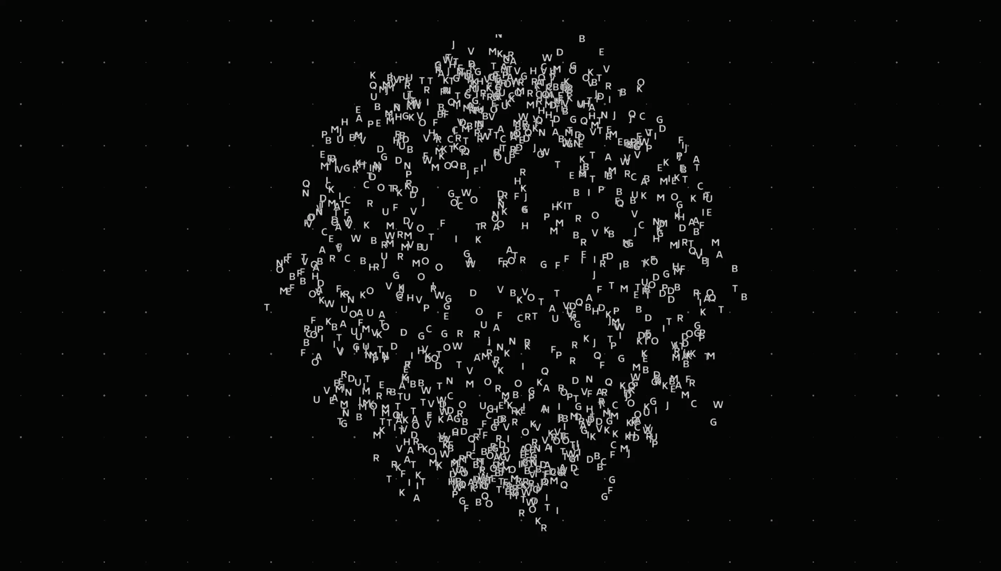
LLMs as a compressed version of the internet
Some like to think of an LLM as a compressed version of the internet
One way of compressing images is to take every other pixel
When you decompress, you interpolate between the pixels
The inclination is to think that some kind of interpolation is happening in LLMs…
…but it’s more complicated than this.
https://www.newyorker.com/tech/annals-of-technology/chatgpt-is-a-blurry-jpeg-of-the-web
Notes:
However, this metaphor does have its limitations, and it might be slightly misleading to think of ChatGPT as a form of lossy compression and then decompression at inference time (as is used in images or videos for example). This kind of compression is usually called lossy because some information is lost along the way. One strategy of controlling for this loss is to apply interpolation.
One simple way to compress an image would be to take every other pixel only. Then during decompression, you can interpolate what the missing pixel is by taking the average value. We can think of LLMs as compressing the internet, and then during inference there is a similar type of interpolation happening.
The inclination is to think that the model has learned the collective works of Shakespeare, and then during the generative stages somehow interpolating in between in some way. However, this may not be happening. There is research to suggest that [interpolation at very high dimensions is equivalent to extrapolation](https://arxiv.org/abs/2110.09485). When we are working in very many dimensions the intuitions that we have can break down. So this analogy of decompression might be unhelpful.

Slide 49
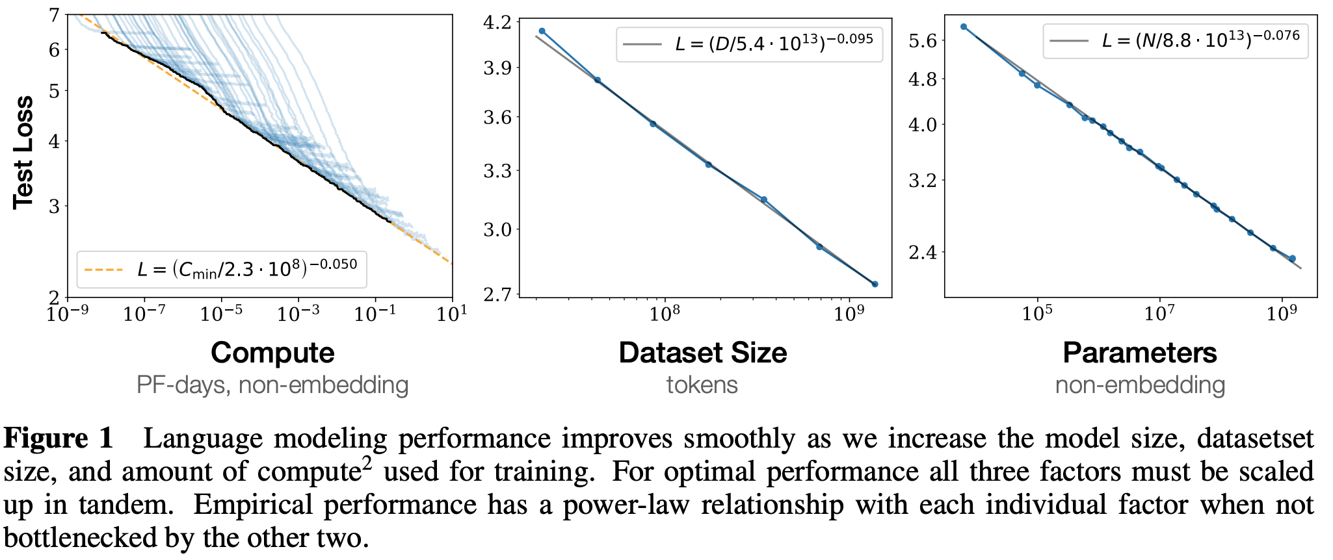

Scaling Laws
Chinchilla scaling laws
$$Loss∝N^{−α}$$
Notes:
Typically, we represent parameters, dataset size, compute cost, and loss as $N$, $D$, $C$, and $L$. And the scaling laws that related them are called the [Chinchilla Scaling Laws](https://arxiv.org/abs/2203.15556), introduced by Google DeepMind in 2022.

Slide 50
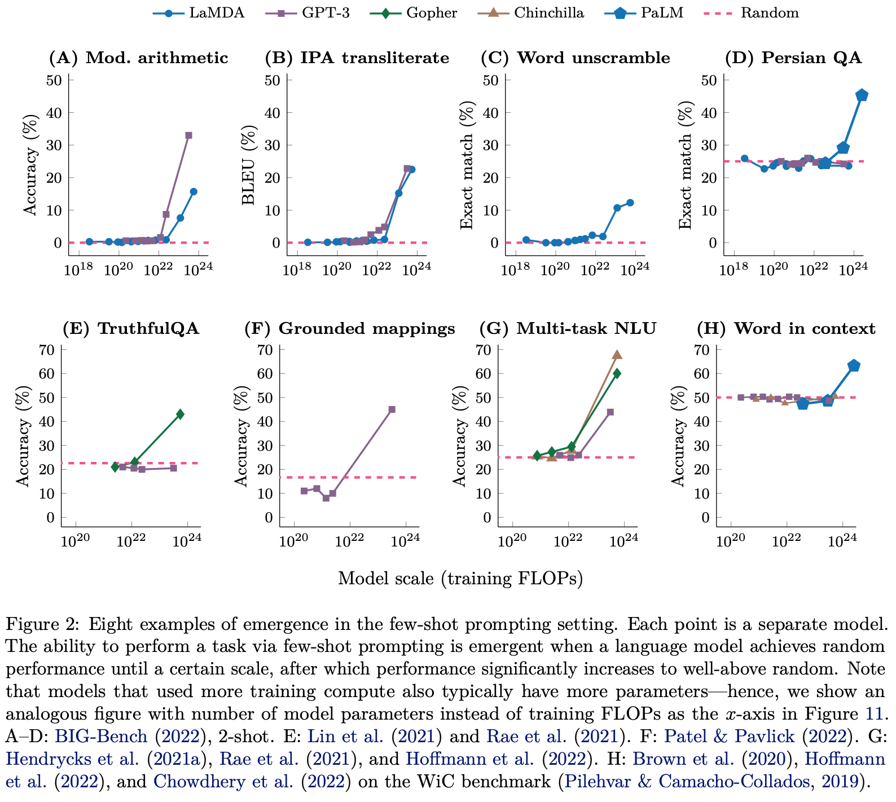
Emergence
Maybe…
Notes:
## Emergence
Without getting too philosophical - emergence has two flavours: _strong_ and _weak_, and can be summarised as the following
**Weak Emergence** Weak emergence is when some newly observed property of a system is a result of the smaller, intereacting components from which it is made. For example, pressure is an emergent phenomenon. Individual particles of air do not have a number that you can attach to each one called "pressure". Instead you attach numbers like "mass" and "velocity". It is only when you consider very many particles of air that you can talk about the pressure of a box of gas. You cannot predict pressure just by observing a single particle, and given a bunch of masses and velocities, pressure might not be immediately obvious. However, you _can_ derive pressure laws (like the ideal gas law), from statistical mechanics (in face, you can derive it from quantum mechanics as well) or from simulations.
**Strong Emergence** Crucially, in weak emergence, the individual components interacting to form the new thing retain independence. If not, then the emergence is said to be strong. Weak emergence is when new properties emerge as a result of the interactions of the components, whereas strong emergence describes a type of downward causal action of the high-level system on the components, and the properties are irreducible to the components, and therefore cannot be simulated or derived. There are no examples of strongly emergent systems in physics.
How does this relate to LLMS!? Emergence is strongly scale dependent: when we are looking at the small scale (like the individual gas particles), we do not see certain properties; we only see them when the system is big enough.
In the same way, LLMs are simply not capable of certain tasks at a small scale. Only when the models become large enough do certain properties emergence.
In the above image, taken from [Emergent Abilities of Large Language Models, Wei et al](https://arxiv.org/abs/2206.07682), shows the sudden emergence of certain abilities as the model size grows.
However, other groups have called these emergent properties a "[mirage](https://arxiv.org/pdf/2304.15004)": for a particular task and model family, emergence appears to be a result of the choice of metric - namely whether they are nonlinear or discontinuous, or linear or continuous.
What is undeniable, is that LLMs exhibit capabilities that were not obvious from the simple next-token prediction task, including:
1. **In-context Learning** Larger models demonstrate the ability to learn from examples given in the prompt, a capability not explicitly trained for.
2. **Chain-of-Thought Reasoning** Some large models can perform multi-step reasoning when prompted correctly, even though they weren't explicitly trained on such tasks.
3. **Zero-shot Task Performance** The ability to perform tasks without specific training examples, solely based on natural language instructions.
4. **Multilingual Capabilities** Models trained primarily on English sometimes develop capabilities in other languages, even without extensive multilingual training data.

Slide 51
Resources
Jargon-free explanation of LLMs
Generative AI exists because of the Transformer
The dangers of Stochastic Parrots
The Pile
Survey of LLMs
Attention is all you need
Intro to Large Language Models
Notes:
.

Slide 52
10 min BREAK

